Slide 2
Diagnostics Improvements in .NET Core 3.0
John Salem (@jsalem206)
Sourabh Shirhatti (@sshirhatti)

Slide 3
What will we cover today?
Runtime features
Diagnostics server
IPC Protocols
Diagnostics tools
dotnet-counters
dotnet-trace (with speedscope.app)
dotnet-dump
How to acquire these tools

Slide 4
Diagnostic Server
.NET Core runtime has a Diagnostic Server exposed via platform-specific transport (Named Pipes/Unix domain sockets)
Custom IPC protocol
Current functionality exposed:
Creating dumps (on Linux)
EventPipe
Attach Profiler
Runtime Client is .NET Library that implements the IPC Protocol
Notes:
Custom IPC control- Request/response like semantics via a custom protocol.
This protocol is a contract made by the runtime. We anticipate APM vendors, profiling vendors, and JetBrains to use this in the future. We still plan to make additive changes going forward

Slide 5
Metrics
Notes:
Now that we know what EventPipe is, let's look at a tool that uses EventPipe.
dotnet-counters is a CLI tool for displaying live updates to EventCounters on a tracee process.
Putting together what we've learned so far, it's really a simple tool. It's a CLI tool that uses the Runtime Client library to receive counter updates and print them to screen

Slide 6
Metrics
.NET runtime and ASP.NET Core emit EventCounters via the EventCounter API.
The runtime will compute additional stats for emitted metrics
Mean, std dev, count, min, max
Usable in low-privilege environments (like xcopy deployments)
Notes:
You can synthesize Counters as well via the EventCounter API
Create an EventSource and emit counters
On the consumption side, metrics are just events! Nothing special about them
The runtime computes additional stats even though the tool doesn’t display them for you
.NET Core doesn’t emit perf counters. This is the only metrics story for .NET Core
Unlike perf counters, these work cross platform

Slide 7
Tracing
Notes:
dotnet trace pretty much work the same way. We use the runtime client library to enable some EventSource providers. One of which is the Microsoft-DotNETCore-SampleProfiler event which allows us to perform CPU profiling.

Slide 8
dotnet trace
Collect EventSource events (including sampled CPU stacks) via EventPipe
Support for GC heap dumps coming soon!
CPU traces can be visualized in Speedscope, VS, Perfview
Chrome dev tools and Cachegrind in the works
Notes:
Only way to Visualize the events is via perfview today. As for visualizing the CPU stacks, we have a couple of options:
- Speedscope.App
Visual studio
More export formats coming soon:
Visual studio is looking to add generic event viewer a la Perfview and also looking at an activity focused view with which we’re working on with them.
Going forward we're looking to curate collections of providers. For example, we'd love to see the NCL team maintain a collection to diagnose workload-specific event in addition to CPU stacks.
It’s worth mentioning the all the dotnet tools support response files which is an easy way to provide list of profiles for customers to collect.

Slide 9
Capturing and Analyzing dumps

Slide 10
Capturing and Analyzing Dumps
No dump collection or analysis on macOS
Windows/Linux are supported (including ARM64 and Alpine)
Doesn’t require sudo, but does require additional privileges
docker run … --cap-add=SYS_PTRACE --security-opt seccomp=unconfined
Collected dumps aren’t portable (require same OS/arch to analyze)
Analyze REPL == SOS without debugger
Notes:
The alpine is huge for folks running in containers. Even getting alpine to build on Alpine was challenging, so dump debugging for containers was impossible prior to this. (libc vs musl)

Slide 11
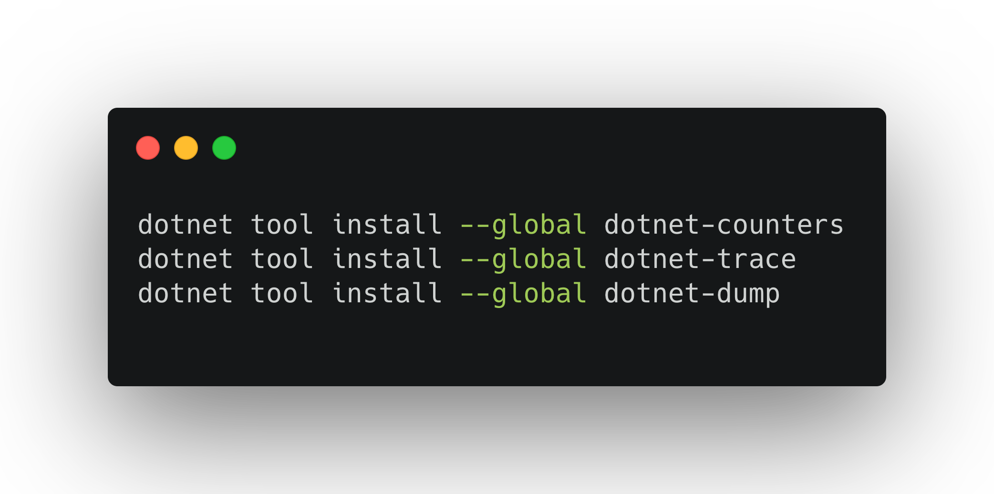
How to acquire these tools

Slide 12
Other tools
dotnet symbol
Tool to download all the files needed for debugging (symbols, modules, SOS and DAC for the coreclr module given) for any given core dump, minidump or any supported platform's file formats like ELF, WinPE, Windows DLLs, PDBs and portable PDBs.
dotnet sos
Tool to install SOS and configure LLDB to load it on startup

Slide 13
Q&A

Slide 14
Framework counters: ADO.NET, EF, Runtime
LTTng
ETW
Event Counters
Custom(User) counters
EventListener
Runtime Events
EventSource
Event Pipe
IPC Stream
ASP.NET Framework logs
ILogger
Logging Sinks
Custom(User) logs
Live process
Core dump
Notes:
Event Pipe is an abstraction in runtime that allows us to share the Eventing Model in the runtime across various different mechanisms to egress events
Same serialization format as ETW. In fact, we still use TraceEvent to process events from Diagnostic Server/EventPipe.
The runtime has preserved the same providers/keywords/events/verbosity. Any ETW knowledge you have here is applicable.
Obviously you no longer get native//OS events from the same pipe like in the case of ETW

Slide 15
Runtime Client
.NET Library that implements IPC Protocol spoken by the Diagnostic Server
“Microsoft.Diagnostics.Tools.RuntimeClient” on https://dotnetfeed.blob.core.windows.net/dotnet-core/index.json
Will ship on NuGet in the ~3.1 timeframe
Notes:
Stable package shipping as an OOB on NuGet after 3.0
Try out the API and give us your feedback
This is currently used in our TechEmpower benchmarks infrastructure to collect metrics. There is no perceptible difference in our benchmarks caused by enabling counters in case you were worried about overhead
Time permitting, show asciinema.org link

